Slide 1

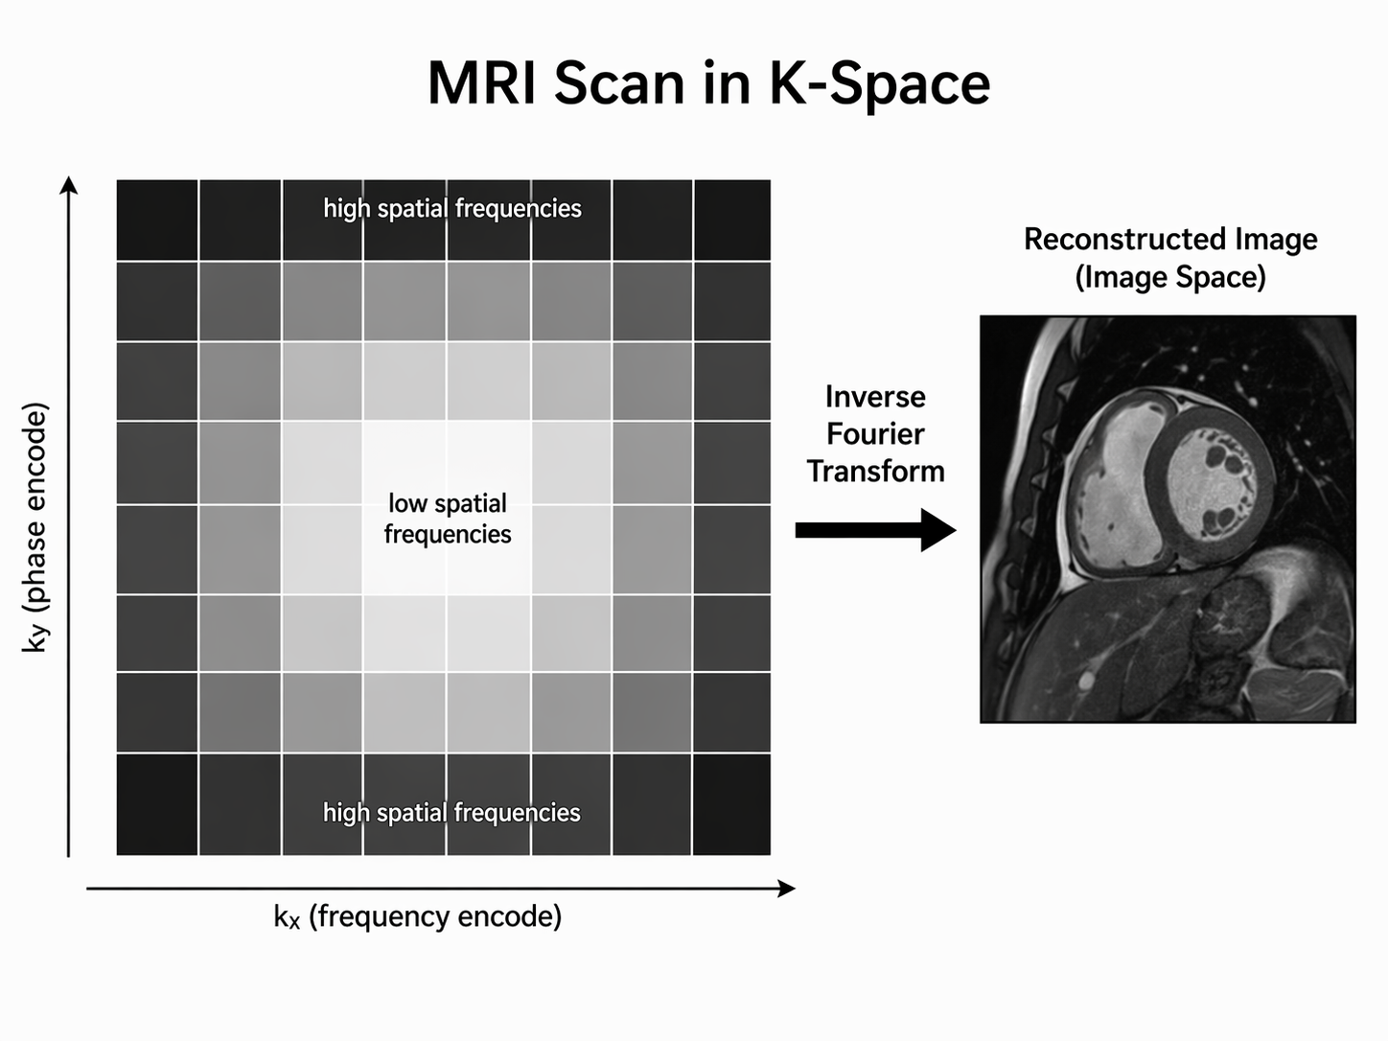
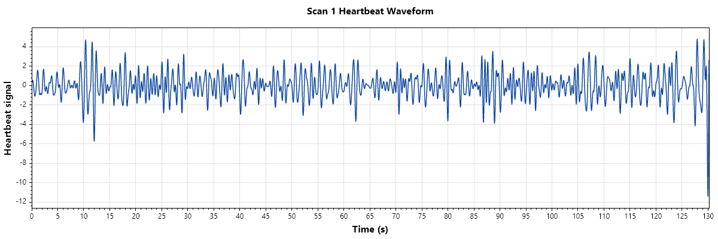
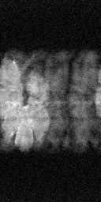
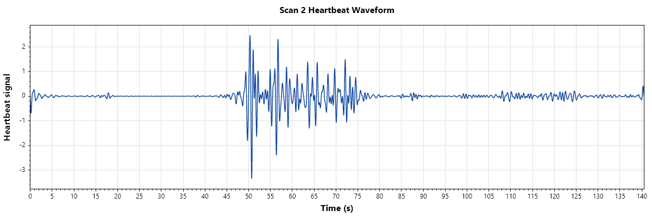
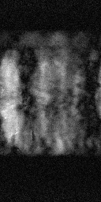
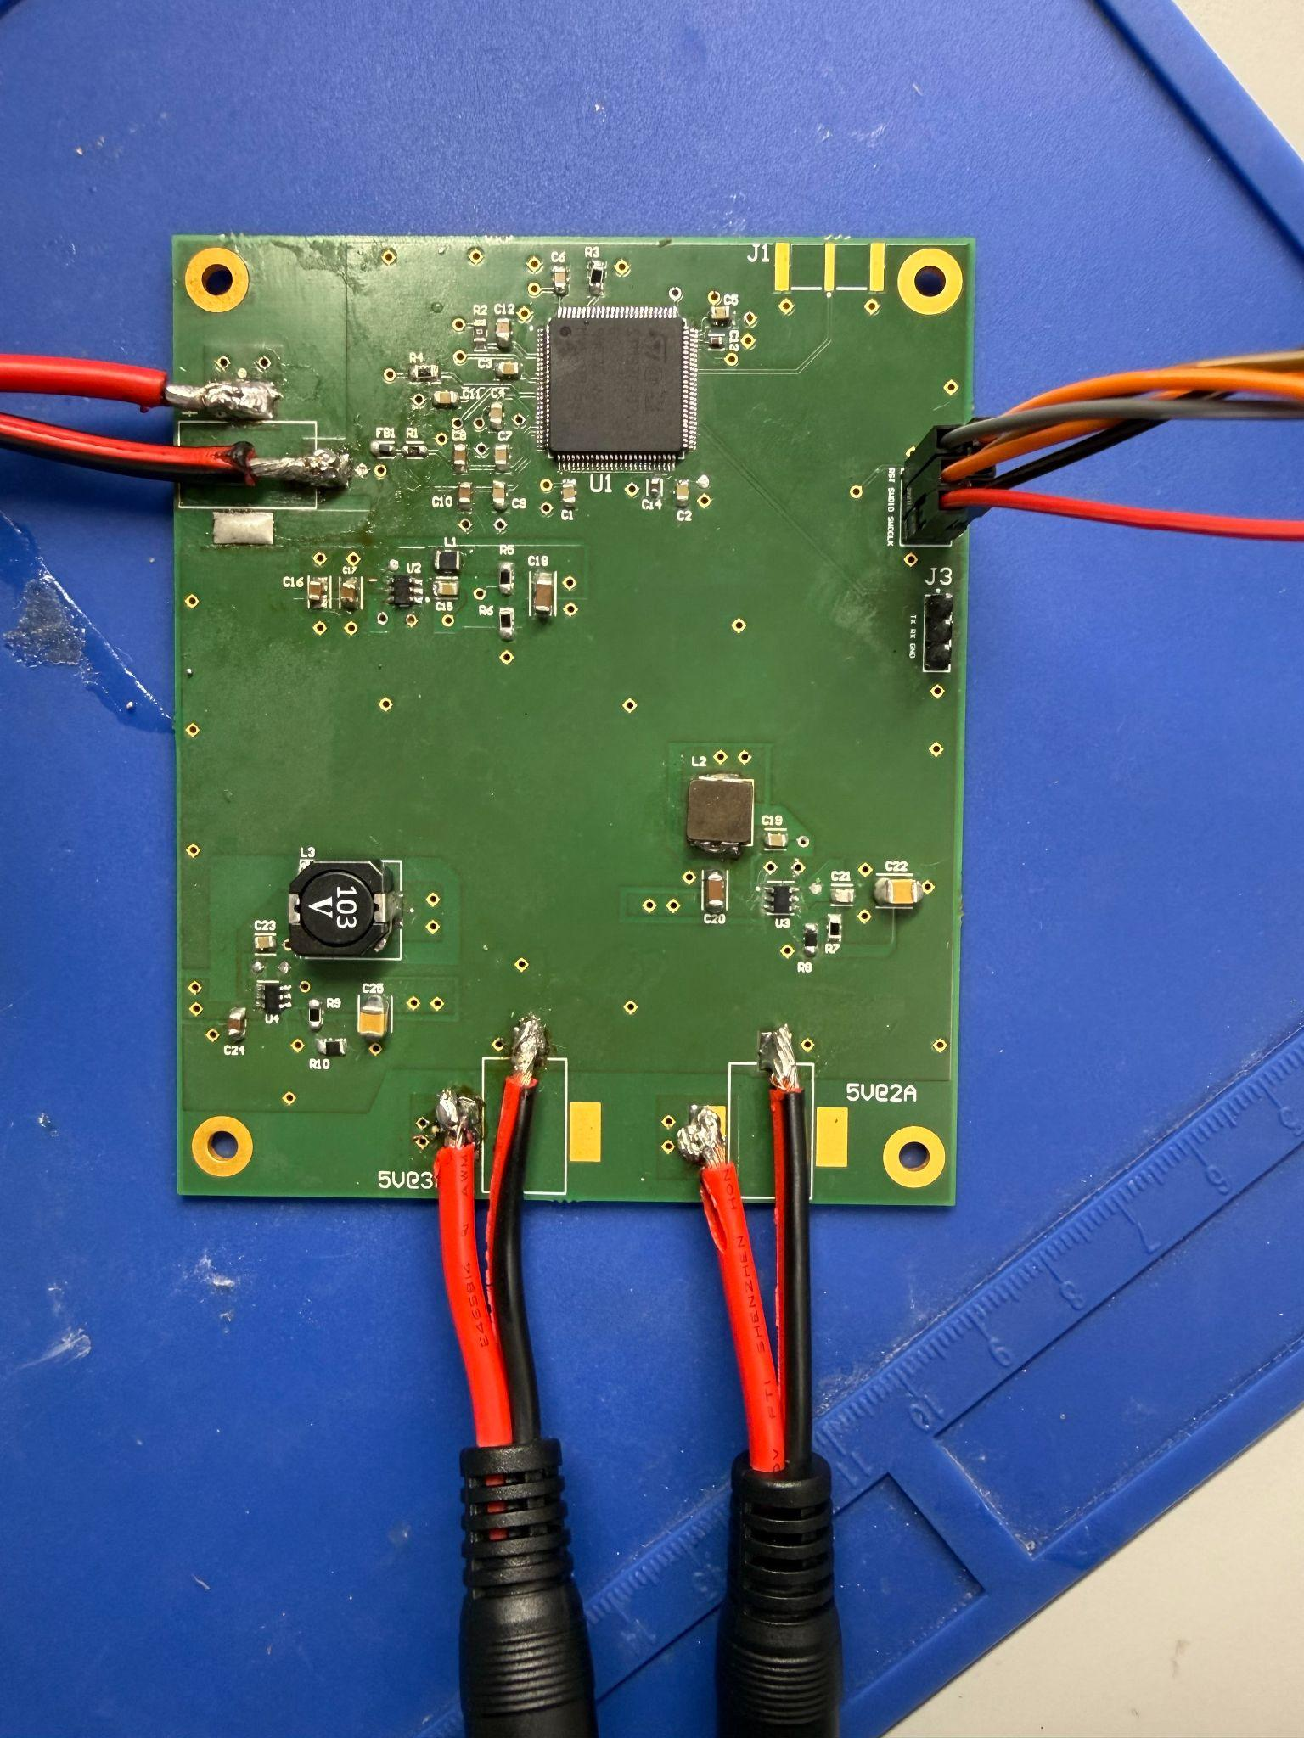
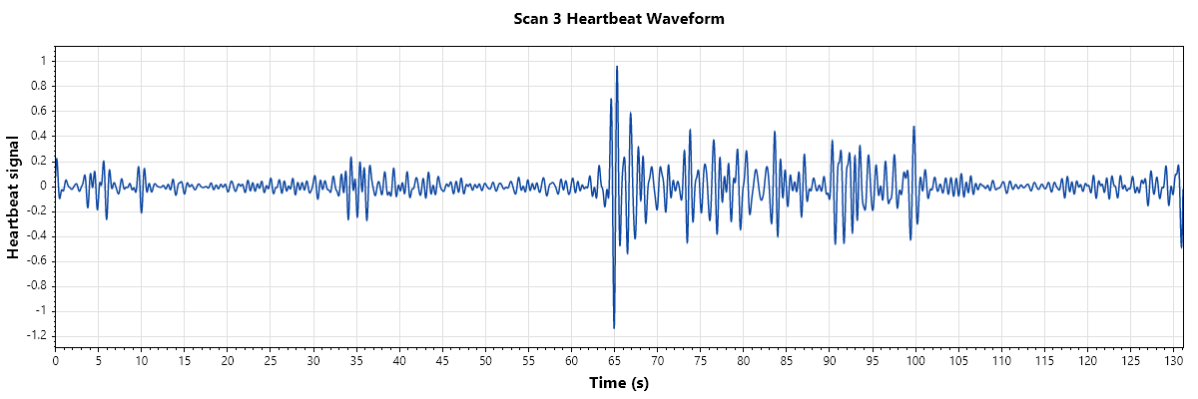
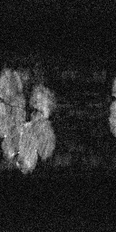
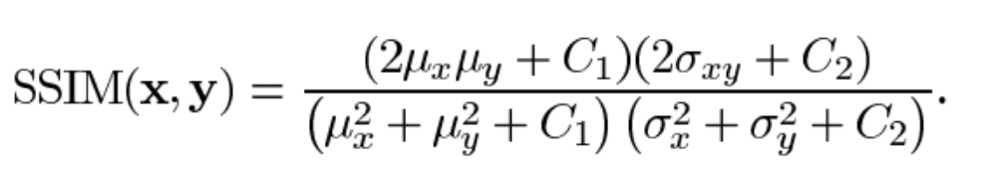
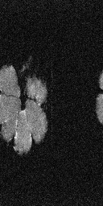
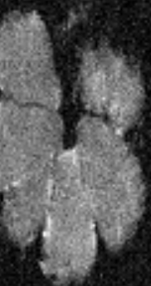
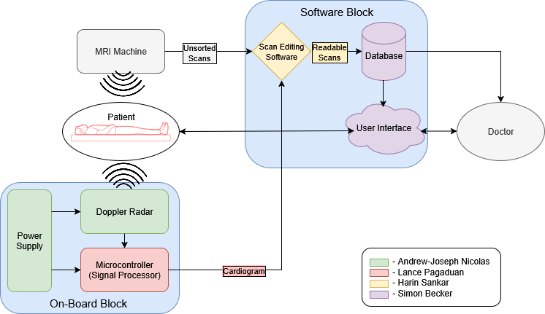
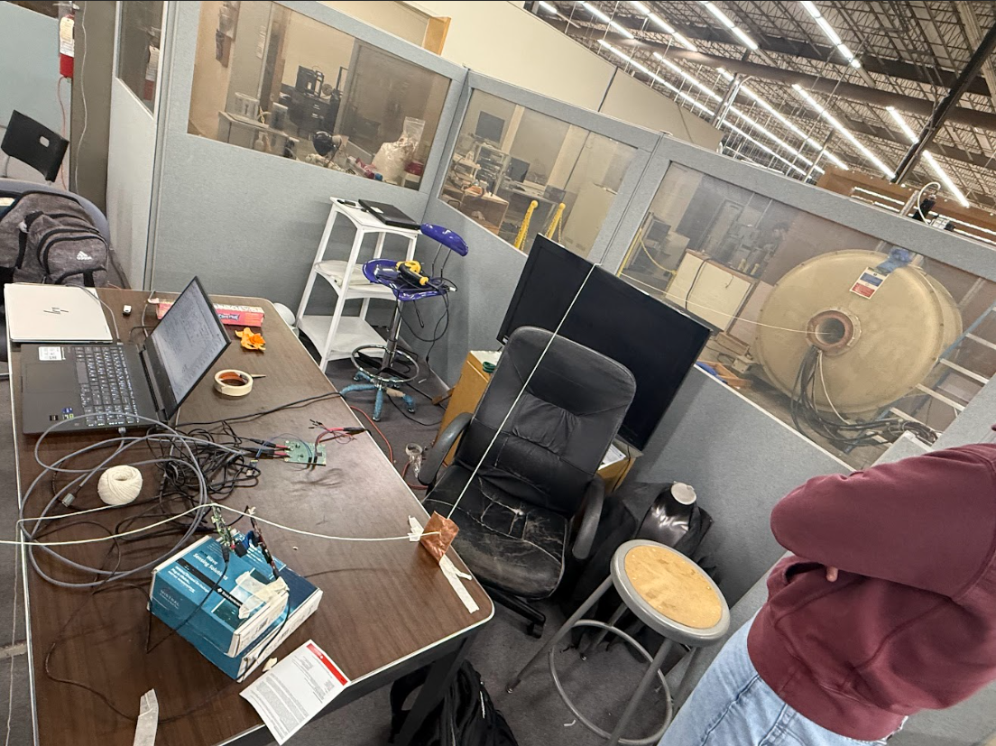
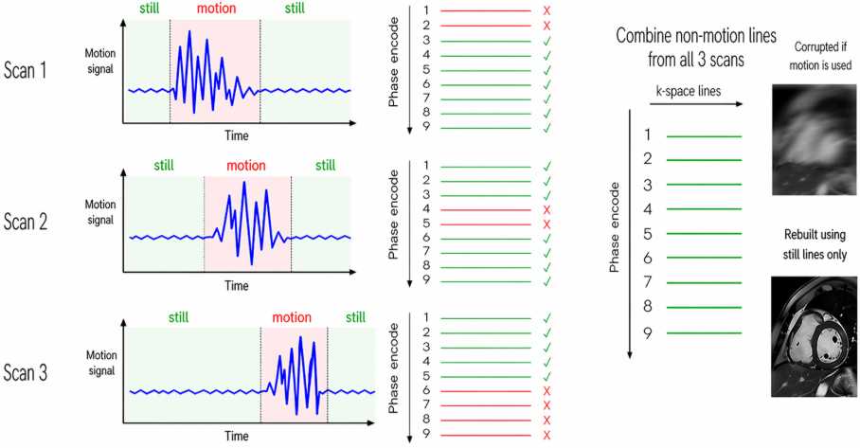
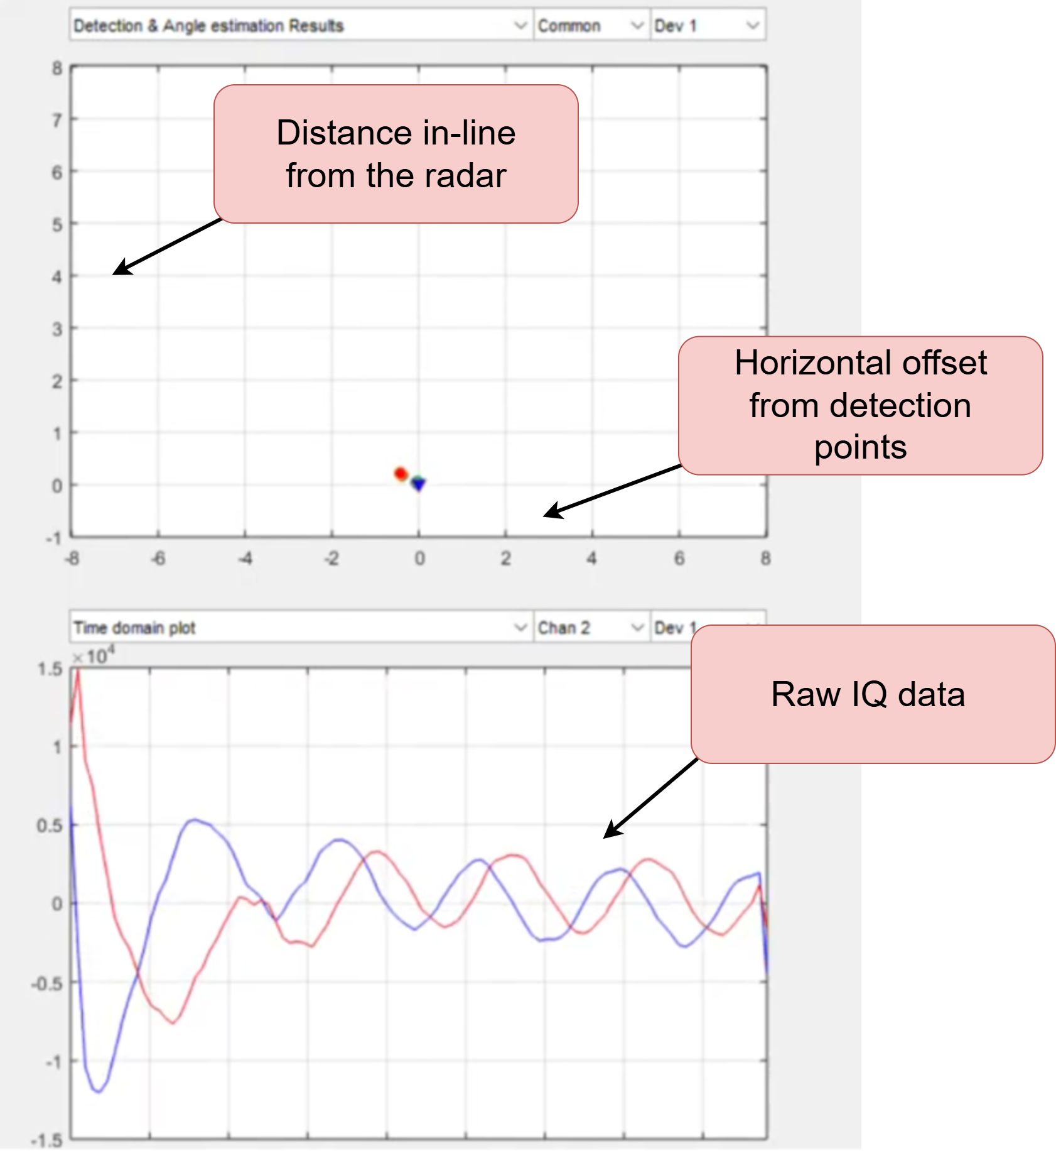
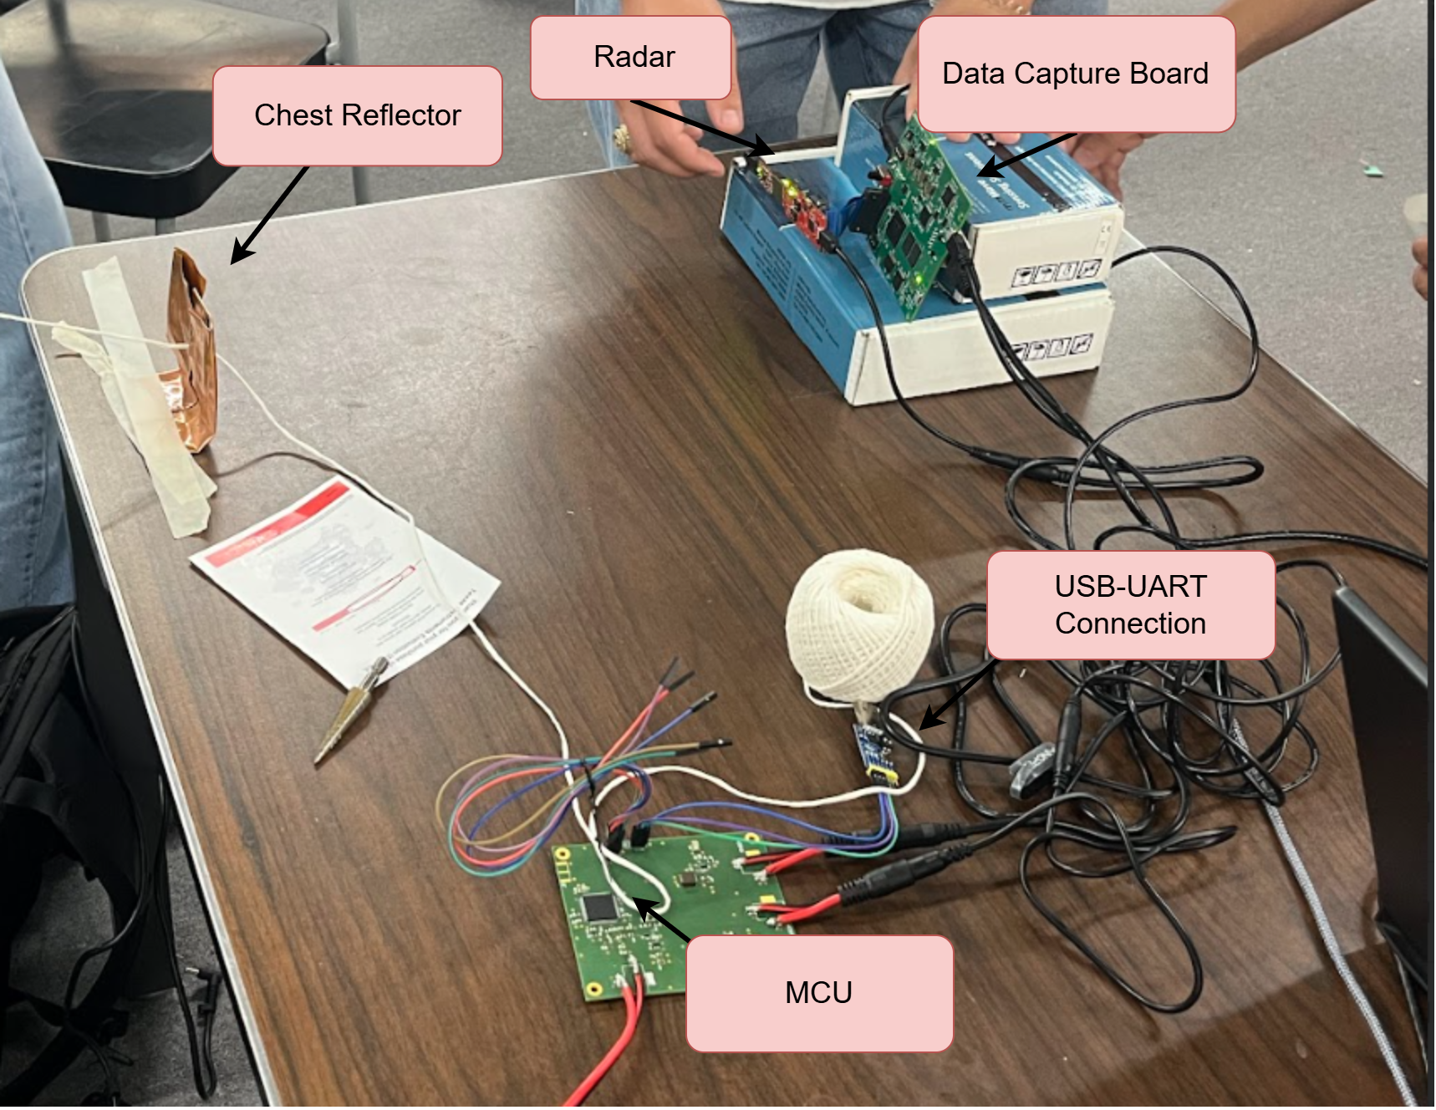
Remote Biometric System Simon Becker, Andrew-Joseph Nicolas, Lance Pagaduan, Harin Sankar Dr. Steven Wright (ECEN), Hailey Ward
Engineering Analysis
During the design process, we faced several challenges, especially when working with MRI machines. From a hardware standpoint, we needed to ensure our system could tolerate the MRI’s magnetic forces. Possible solutions included avoiding magnetic materials, building a magnetic shield housing, or increasing the radar’s distance from the MRI. We chose to optimize the radar’s distance because it kept material costs low while still allowing the use of traditional PCB and DIP methods.
Another key consideration was whether the MRI magnetic field would affect the radar signal. We found this was not a major issue because the two systems operate very differently electromagnetically. MRI relies on a strong static magnetic field and RF excitation in the tens to hundreds of MHz range, while the radar operates at 60 GHz. Since the MRI’s main magnetic field is static, it does not create time-varying energy that would significantly couple into or distort the radar signal.
To properly filter scans with detected movement, the team first needed a strong understanding of how MRI images are formed. MRI builds images by collecting raw signal data in k-space, where each acquired signal contributes part of the final scan. Cardiac gating then uses a cardiogram as a timing reference to match each k-space line to a point in the cardiac cycle, allowing motion-corrupted data to be rejected and low-motion data to be combined into a clearer image with fewer motion artifacts.
Another challenge of working with MRI systems was handling their data, since many scan files use closed-source, vendor-specific formats. To avoid this issue, and to match the MRI machines available in the lab, we chose the vendor-neutral “.mrd” format. With help from our staff sponsor, Professor Steven Wright, we obtained example scans, including both corrupted and control outputs.
Our final major challenge was limited end-to-end testing. The available MRI machines were too small for human subjects, university rules prohibited testing on people, and scan time was limited because the machine required both funding and an operator. To address this, the team used an orange attached to a string as a phantom. When the string was pulled, the radar detected the motion, which correlated with the motion of the orange.
Outcomes
Scan Filter Results
Problem Definition
Magnetic Resonance Imaging is expensive and time consuming, and these problems are only getting worse. Patient throughput is a key area that can be improved upon, and our project seeks to speed up a specific step of the MRI process: cardiac gating. Cardiac gating is the process by which the cardiac cycle is monitored, motion-corrupted parts of scans caused by cardiac movements are removed, and the image is reconstructed using uncorrupted parts of scans from areas of low motion.
Currently, this is done by using electrical contacts attached to the chest of the patient. While accurate and proven, this methodolgy can require prior prep time and is often seen as uncomfortable and time-consuming by patients and medical providers alike. Our project seeks to accomplish the cardiac gating process, instead using millimeter wave radar to detect chest movement and heart rate. This allows for patients to get in, get scanned, and get out at a much faster rate than current methods.
Methodology
Components
Radar - Extracts chest movements to generate IQ data. This acts as the ECG lead alternative.
MCU - Calculates biometric data and outputs a cardiac waveform.
Scan Editing Software - Compares MRI data with MCU generated cardiogram data to filter unwanted scans
User Interface - Takes final sorted scans from scan filter for patients and doctors to collaborate and mark up the result scan
Impact
Replacing ECG leads with mmWave radar for MRI cardiac gating would significantly improve scanner throughput and workflow efficiency. Current ECG-based gating requires 5–15 minutes of pre-scan preparation per patient. A non-contact radar system eliminates this overhead entirely, providing “better patient handling and throughput”¹. Eliminating per-patient lead placement time across even 10 cardiac MRI scans per day could recapture 50–150 minutes of scanner time, translating directly into additional exam capacity along the lines of the $22M annual revenue².
Beyond throughput, mmWave radar gating addresses several clinical failure modes that ECG leads cannot. In patients with cardiac implantable electronic devices, approximately 50–75% of whom will require MRI over their device lifetime³, ECG-based gating requires elaborate pre- and post-scan protocols including device reprogramming and electrophysiology nurse monitoring⁴. Radar also extends cardiac gating to populations where ECG leads are difficult or contraindicated: burn patients, neonates with fragile skin, and those with abnormal chest geometry, all of whom show elevated ECG gating failure rates in current practice⁵.
References
[1] PMC11806077 — CW Doppler radar MRI feasibility study, IEEE TBME, 2024
[2] Woolen et al., Radiology, 2024 — Scan time reduction financial/environmental impact
[3] Canadian Journal of Cardiology joint statement, 2021
[4] PMC4010944 — MRI in patients with CIEDs, institutional protocol review
[5] PMC2396326 — Self-gated cardiac cine MRI (ECG limitations overview)
Acknowledgments
Special thanks to Jacob Ruff, for performing our test scans
Scan 1
Scan 2
Scan 3
Reference Scan
Reconstructed Scan
SSIM = 0.849385
Radar Results

